Slide 1
NAME : CHAARUBHALA.S
REG NO : 813821104022
CLASS : III Yr. B.E.
DEPARTMENT : Computer Science and
Engineering

Slide 2
PROJECT TITLE
Handwritten Digit Recognition with Multi-Layer Perceptron Classifier

Slide 3

AGENDA
Problem statement
Project Overview
Who are the end users?
Solution and its value proposition
Wow in my solution
Modelling
Result
Conclusion
3/21/2024 Annual Review

Slide 4

PROBLEM STATEMENT
Develop a system capable of accurately recognizing handwritten digits from images. Given a dataset containing images of handwritten digits along with their corresponding labels, the task is to train a machine learning model, specifically a Multi-Layer Perceptron (MLP), to correctly classify these digits into their respective categories.

Slide 5

PROJECT OVERVIEW
Handwritten digit recognition using Multi-developmentLayer Perceptron (MLP) involves the of a system capable of accurately identifying handwritten digits from images.
Utilizing datasets,the project entails preprocessing images, designing an MLP architecture comprising input, hidden, and output layers, and training the model using techniques like backpropagation and optimization algorithms.
The trained model's performance is evaluated on validation and testing datasets, measuring metrics such as accuracy, precision, recall, and F1-score.

Slide 6

WHO ARE THE END USERS?
General Consumers
Researchers and Developers
Educational Institutions
Businesses and Organizations
Government Agencies
Assistive Technology Users

Slide 7

SOLUTION AND ITS VALUE PROPOSITION
Accuracy
Scalability
Speed and Efficiency
Flexibility
Reliability and Robustness
Automation and Integration

Slide 8

THE WOW IN MY SOLUTION
Implementing a real-time recognition feature that allows users to capture handwritten digits through a webcam or mobile camera and receive instant recognition results.
Ensuring compatibility with multiple platforms and devices, including desktop computers, mobile devices, and web browsers, to maximize accessibility and usability for users across different environments.
3/21/2024 Annual Review

Slide 9
MODELLING
The Multi-Layer Perceptron (MLP) is a type of artificial neural network that consists of multiple layers of nodes, or neurons, arranged in a feedforward manner.
The components and functioning of an MLP model are
Input Layer
Hidden Layers
Activation Functions
Output Layer

Slide 10
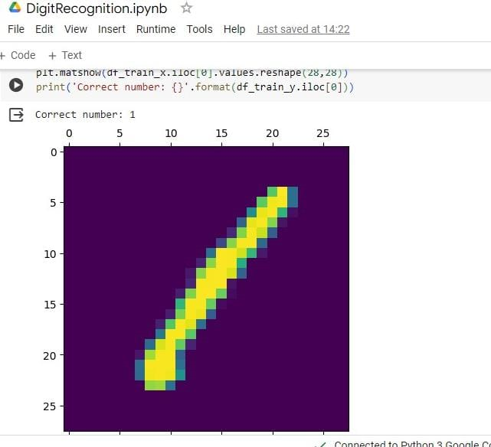
RESULTS

Slide 11
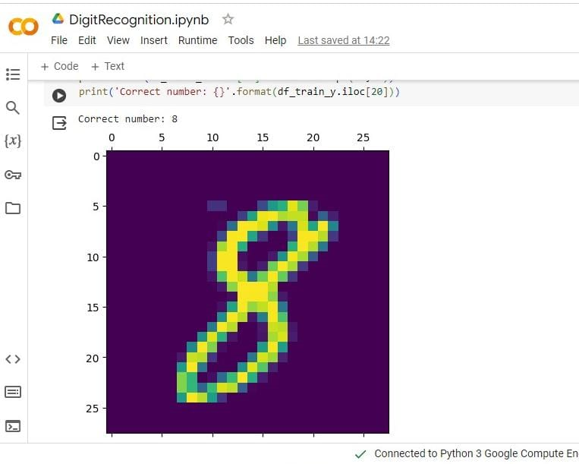
RESULTS

Slide 12
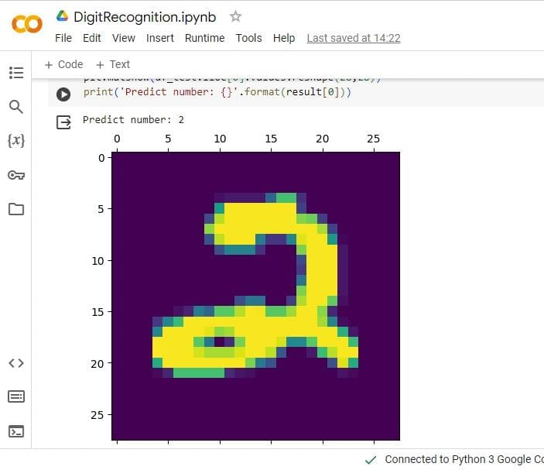
RESULTS

Slide 13
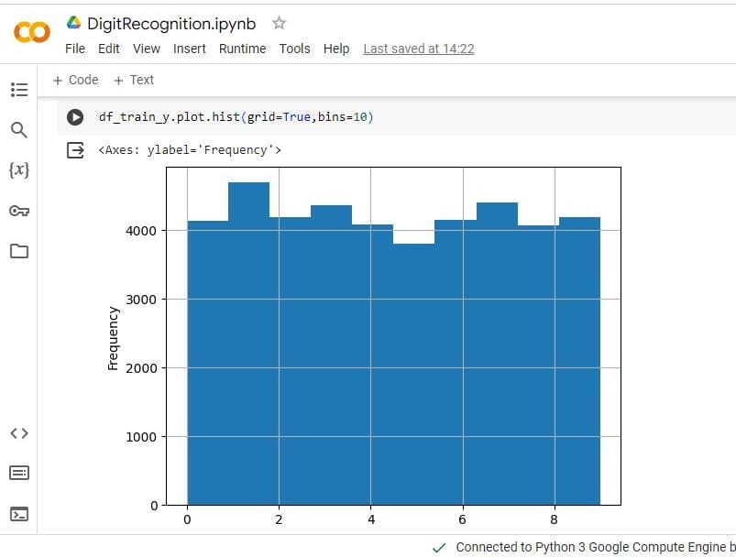
RESULTS

Slide 14
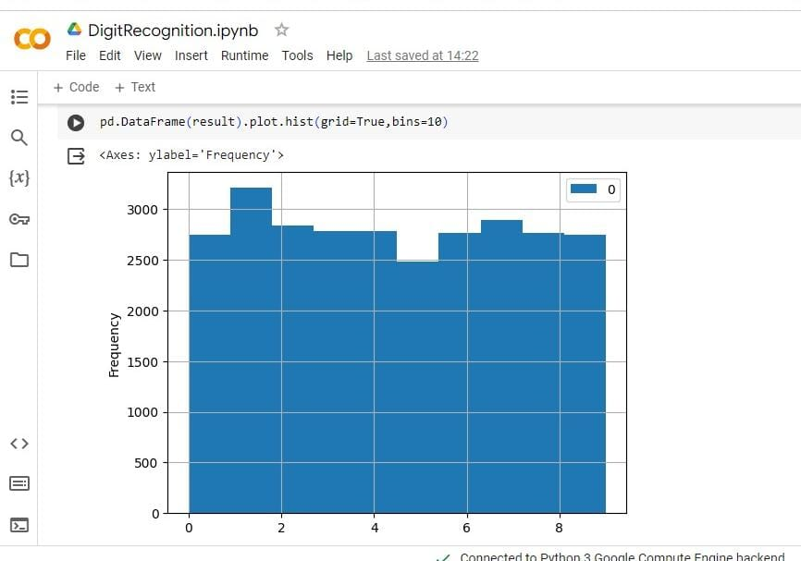
RESULTS

Slide 15
CONCLUSION
The project aims to develop a robust system for handwritten digit recognition using MLP, leveraging the dataset as a benchmark.
By following a structured methodology and comprehensive evaluation, the project aims to achieve accurate classification results and provide insights for future improvements and applications.

